Slide 1

Analysis of the influence of socio-economic indicators of countries on salary trends in the fields of
Data Science
Iuliia Bolgova
Data Science Intensive Capstone Project, March 11th 2024 Cohort

Slide 2
Problem Statement
Research Objective
The rapid expansion of the Data Science field has led to significant changes in salaries and working conditions. This research aims to understand how data science salaries correlate with various socio-economic indicators globally
To identify factors influencing data science salaries and develop a predictive model for these salaries

Slide 3
Datasets
01
02
Kaggle
Kaggle
Latest Data Science Salaries Dataset
Global Country Information Dataset 2023
KEY COLUMNS:
Job Title
Employment Type
Experience Level
Salary in USD
Company Location
etc
Population Density
GDP
Life Expectancy
Minimum Wage
Unemployment Rate
etc

Slide 4
Data Wrangling
Initial Inspection
Data Cleaning
Merged Dataset
dataset 01 dataset 02
YES YES
NAN NAN
new dataset
47
COLUMNS
5,702
RECORDS
dataset 01 dataset 02
11 42
COLUMNS COLUMNS
5,702 195
RECORDS RECORDS
Minimum Wage missing values filled using median values
NO YES
DUPLICATES DUPLICATES
COUNTRY
KEY COLUMN
Removed duplicate country records
YES YES
CORRECTING CORRECTING
DATA TYPES DATA TYPES

Slide 5
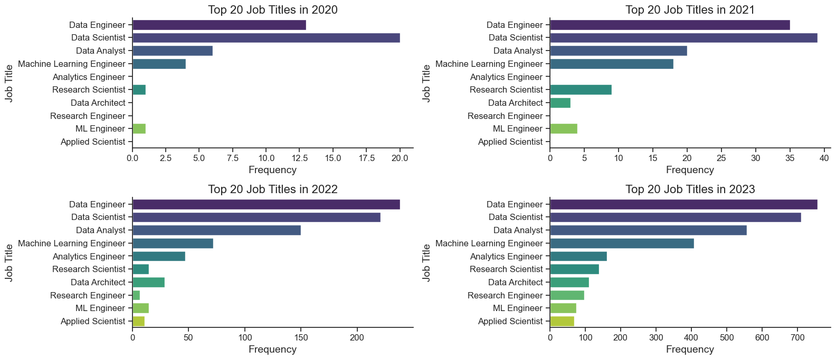
Exploratory Data Analysis (EDA)
Top 20 Job Titles by Year
Data Engineer and Data Scientist remain the most in-demand job titles.
Analytics and machine learning positions are also gaining popularity.

Slide 6
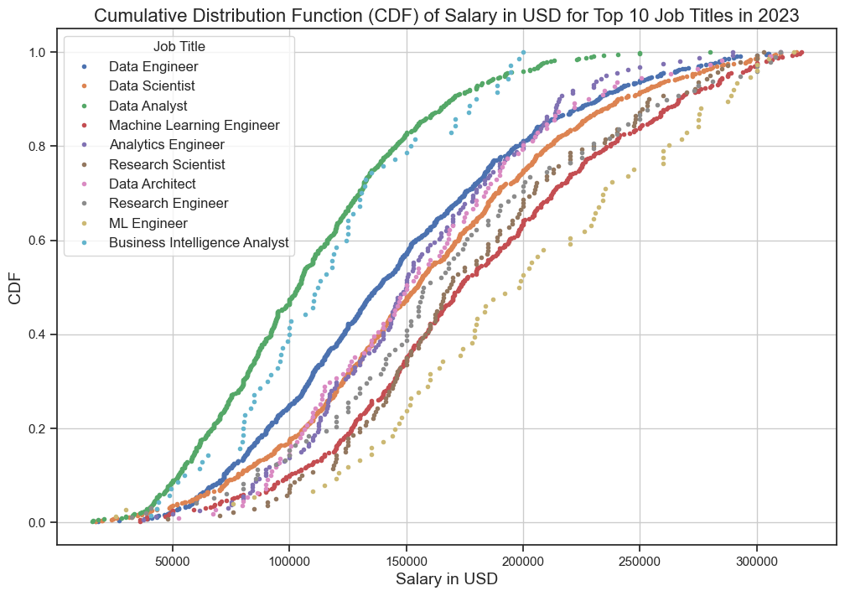
Exploratory Data Analysis (EDA)
Cumulative Distribution Function (CDF) of Salary in USD for Top 10 Job Titles in 2023
In 2023, salaries vary significantly across roles. Data Engineers and Data Scientists are the most frequent job titles, with most salaries clustering between
$100,000 - $200,000 USD

Slide 7
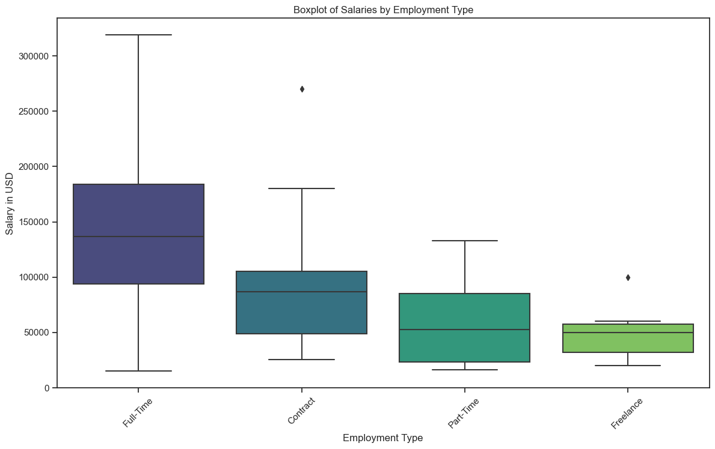
Exploratory Data Analysis (EDA)
Salaries by Employment Type
Full-time positions offer the highest median salaries compared to contract, part-time, and freelance positions.
Full-time roles also show a higher degree of salary variability. The distribution of vacancies by employment type shows a dominance of full-time positions across the dataset

Slide 8
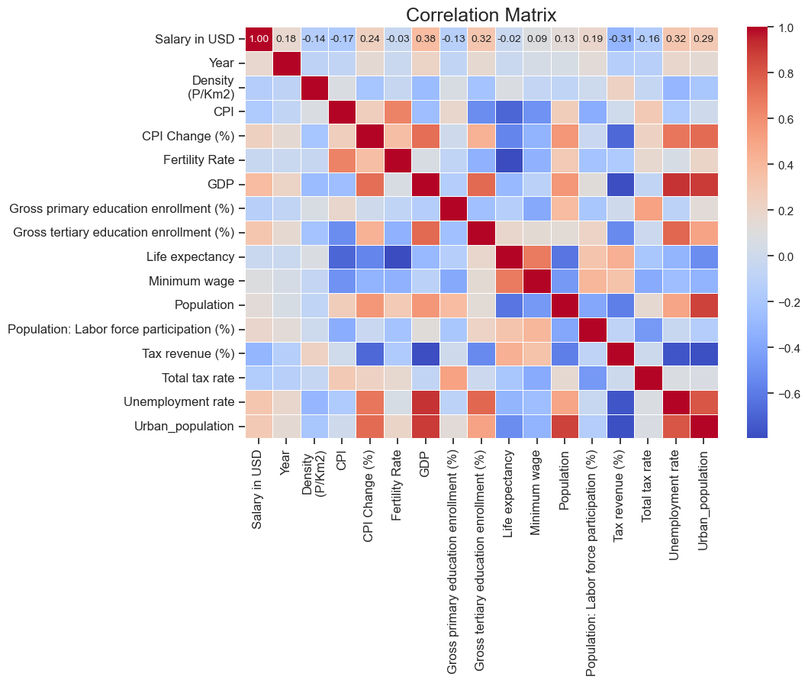
Exploratory Data Analysis (EDA)
Correlation Analysis
Key Findings for Salary in USD
Minimum Wage (0.32)
Population Labor Force Participation (0.19)
POSITIVE CORRELATION
Unemployment Rate (-0.16)
CPI Change (-0.14)
NEGATIVE CORRELATION

Slide 9
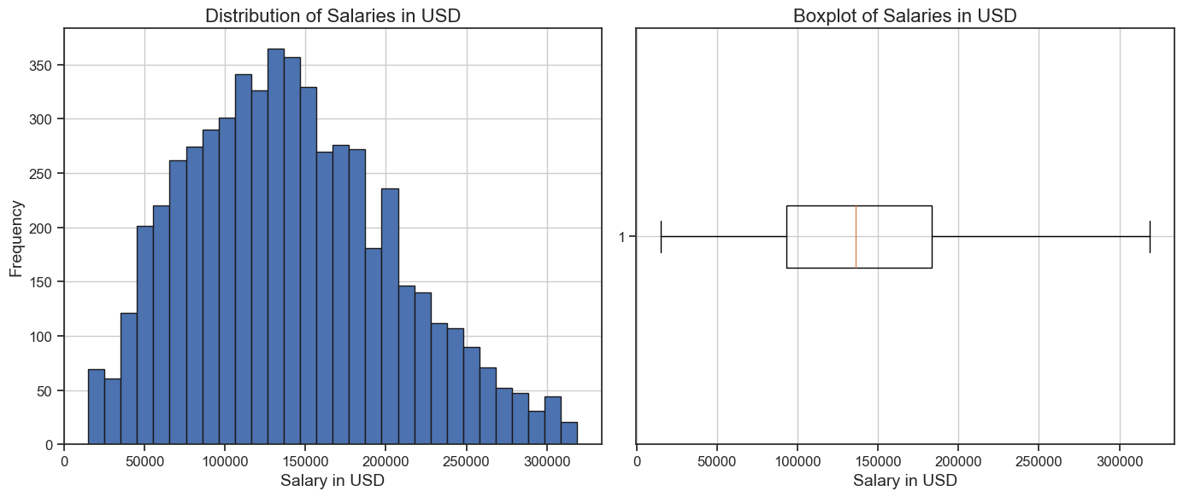
Exploratory Data Analysis (EDA)
Salary Distribution
$140,000
MEDIAN
Right-skewed
DISTRIBUTION
$100,000 - $180,000
IQR

Slide 10
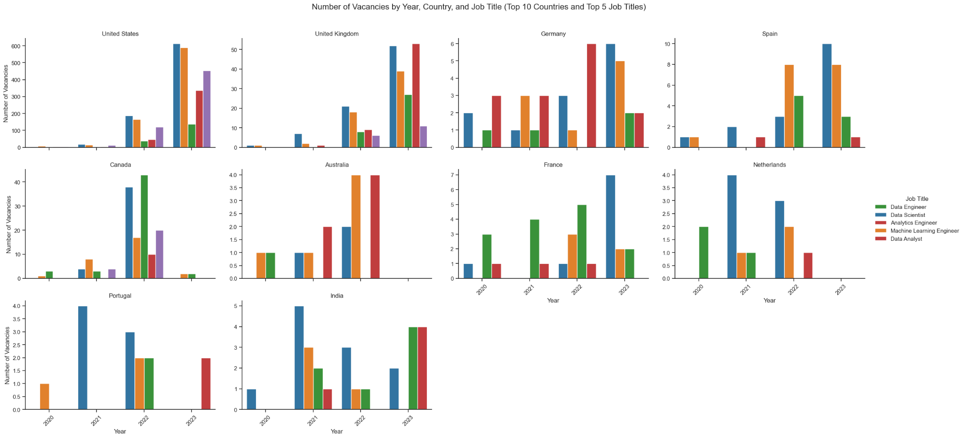
Exploratory Data Analysis (EDA)
Vacancies by Country and Job Title

Slide 11
Preprocessing and Training Data
01
02
03
Dummy Encoding
Standardization
one-hot encoding
47 5,702
COLUMNS RECORDS
StandardScaler
Split into Testing and Training Datasets
All columns except Salary in USD
FEATURES (X)
Salary in USD
TARGET VARIABLE (y)
80% 20%
TRAINING DATA TESTING DATA

Slide 12
Applying the Machine Learning Models
01
02
03
04
05
The following regression models were used
Random Forest
Ridge Regression
Hyperparameter Optimization
RandomizedSearchCV |GridSearchCV
3-fold Cross-Validation
Tuned parameters for each model
Lasso Regression
XGBoost
Gradient Boosting

Slide 13
Feature Selection and Importance
SALARY CURRENCY
Most significant feature influencing salary
MINIMUM WAGE
Strongly correlated with salary
GDP
Strongly correlated with salary
JOB TITLE
Critical in determining salary variations
YEAR
Reflects trends over time
LABOR FORCE PARTICIPATION
Higher participation rates correlate with higher salaries
EXPERIENCE LEVEL
Critical in determining salary variations
COMPANY SIZE
Larger companies often offer higher salaries
COUNTRY OF RESIDENCE
Geographic location impacts salary levels

Slide 14
Comparison of the Models: METRICS
Model | MAE | MSE | RMSE | R^2 | Training Time (s) | Prediction Time (s) | Complexity | Scalability | Maintenance Costs
Random Forest | 0.6119 | 0.5943 | 0.7710 | 0.4020 | 87.39 | 0.054 | High | Good | Medium
Ridge Regression | 0.6060 | 0.5812 | 0.7623 | 0.4152 | 0.50 | 0.0026 | Low | Excellent | Low
Lasso Regression | 0.8160 | 0.9940 | 0.9970 | -0.0001 | 0.40 | 0.0019 | Low | Excellent | Low
XGBoost | 0.5995 | 0.5711 | 0.7557 | 0.4254 | 5.19 | 0.0067 | High | Excellent | High
Gradient Boosting | 0.6011 | 0.5716 | 0.7554 | 0.4249 | 34.31 | 0.0035 | High | Good | High

Slide 15
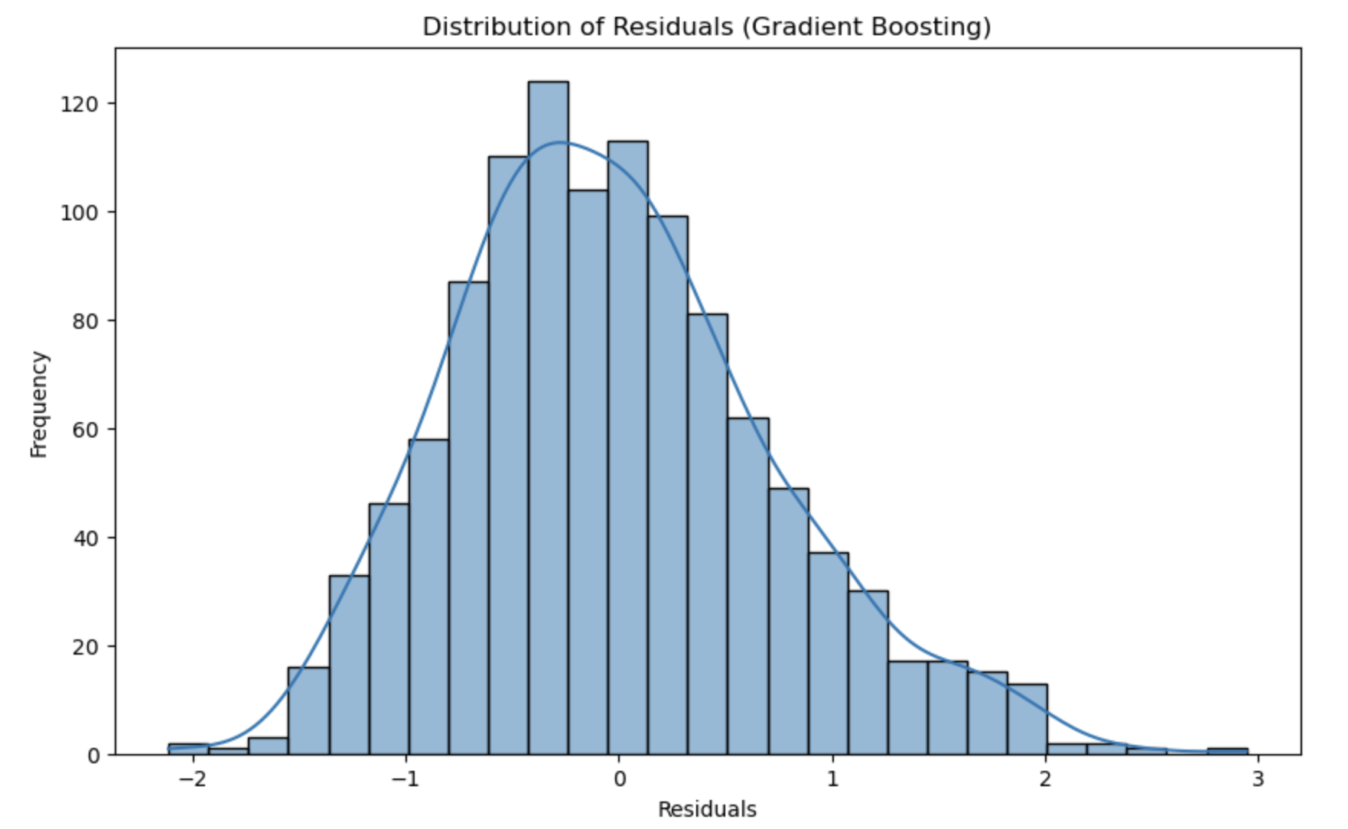
Applying the Machine Learning Models
Gradient Boosting Regressor (Selected Model)
Residuals
differences between the actual and predicted salaries
most residuals are close to zero

Slide 16
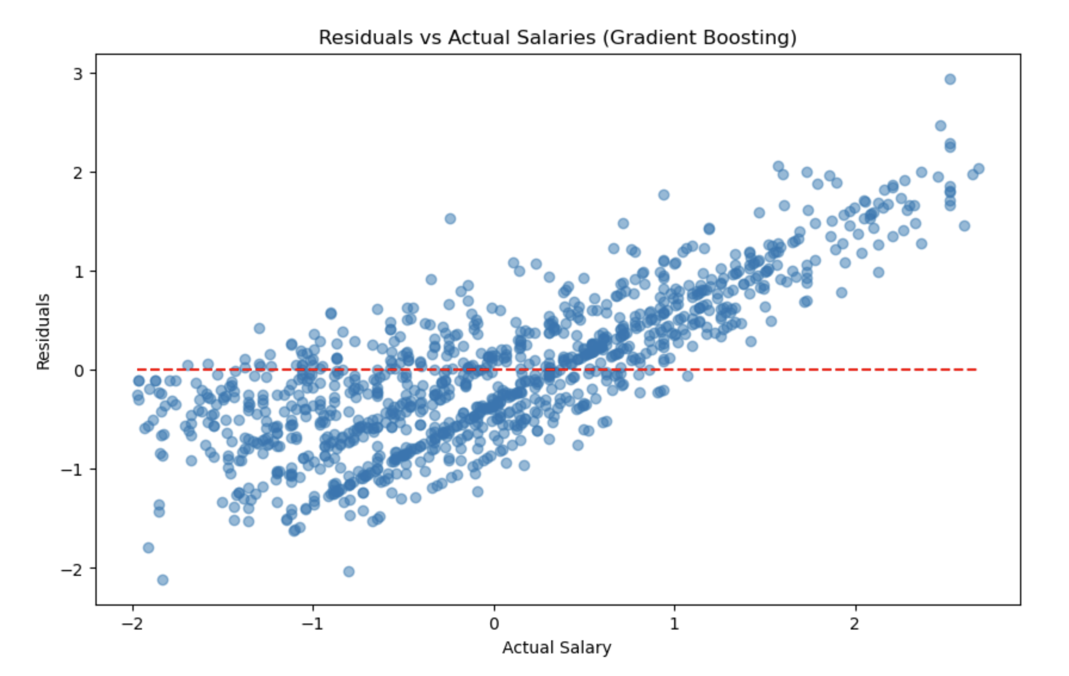
Applying the Machine Learning Models
Gradient Boosting Regressor (Selected Model)
The plot shows that most residuals are close to zero, but there is some dispersion, especially for higher and lower actual salary values. This indicates that the model might underperform for extreme values

Slide 17
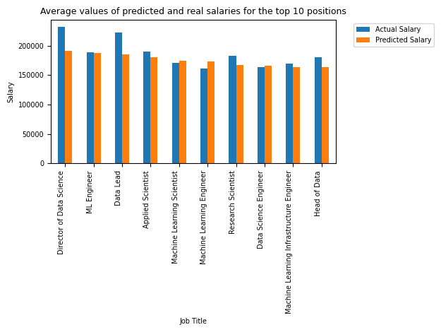
Applying the Machine Learning Models
Salary Predictions
Job Title | Actual Salary (USD) | Predicted Salary (USD)
Director of Data Science | 232,038.12 | 190,985.24
ML Engineer | 188,916.85 | 188,216.80
Data Lead | 222,007.22 | 185,289.82
Applied Scientist | 189,668.81 | 180,643.97
Machine Learning Scientist | 170,703.32 | 173,878.11
Machine Learning Engineer | 161,281.71 | 173,493.83
Research Scientist | 183,121.68 | 167,145.79
Data Science Engineer | 163,335.33 | 166,077.19
Machine Learning Infrastructure Engineer | 169,813.91 | 163,147.69
Head of Data | 180,587.78 | 163,138.39
The model is accurate for technical roles but tends to underestimate salaries for senior and leadership positions. Further refinement is needed to better capture the dynamics of high-level roles.

Slide 18
Summary
RECOMMENDATION
IMPROVEMENT SUGGESTION
Gradient Boosting | XGBoost
for high accuracy and robustness
Advanced Feature Engineering
to capture complex relationships
Additional Data Incorporation
more socio-economic indicators and market trend data to enhance model accuracy
Hyperparameter Tuning
Bayesian optimization and grid search

Slide 19
Summary
KEY FINDINGS
IMPLICATIONS
Identified factors influencing data science salaries and developed predictive models
Insights can help professionals and organizations make informed career and salary decision
The XGBoost and Gradient Boosting models accurately predicted data science salaries

Slide 20
Thank you!
For any questions please text me on email: julibolg@gmail.com

